Slide 1

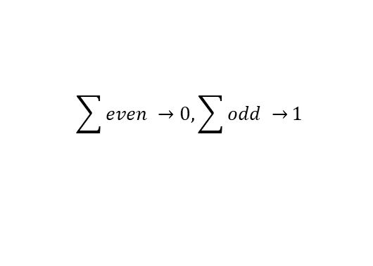
Algorithm at Alice’s side
Original bits
1 | 0 | 0 | 1 | 1 | 0 | 0 | 1
0 | 1 | 1 | 0 | 1 | 0 | 1 | 1
$$\sum{even →0, \sum{odd →}1}$$
Parity bit of outcomes is communicated to Bob

Slide 2
Algorithm at Bob’s side
Original bits
1 | 0 | 0 | 1 | 1 | 0 | 0 | 1
Alice’s bit
0
0 | 1 | 1 | 0 | 1 | 0 | 1 | 1
$$\sum{even →0, \sum{odd →}1}$$
Parity bit of Bob’s outcomes XOR Alice’s bit is Bob’s guess

